Slide 1


UNDERGRADUATE RESEARCH · EE 28499 · SPRING 2026
Uncertainty & LLM-Guided
Environment Generation
for NeuroCotans
Amir Tomashpayev
Prof. Toros Arikan
Student
Advisor · Wireless Institute
UNIVERSITY OF NOTRE DAME · DEPARTMENT OF ELECTRICAL ENGINEERING

Slide 2
THE PROBLEM
Where is that boundary, and how sure are we?
A sonar pulse goes out.
boundary
It bounces off something underwater.
We hear an echo.
ρ
Where exactly was the surface?
θ
NeuroCotans answers with two numbers: ρ (distance, 0–10 m) and θ (angle, 0–360°).
receiver
ρ = distance θ = bearing
NeuroCotans · Amir Tomashpayev · Spring 2026
2 / 9

Slide 3




THE PIPELINE
From acoustic echo to a confident prediction
1
2
3
4
›
›
›
Sonar measurement
COTANS transform
Trained UNet
Boundary location
raw acoustic data
101×360 heatmap
segmentation
(ρ, θ) output
CONTRIBUTION 1
CONTRIBUTION 2
LLM-guided environment generation
MC Dropout uncertainty estimation
NeuroCotans · Amir Tomashpayev · Spring 2026
3 / 9

Slide 4


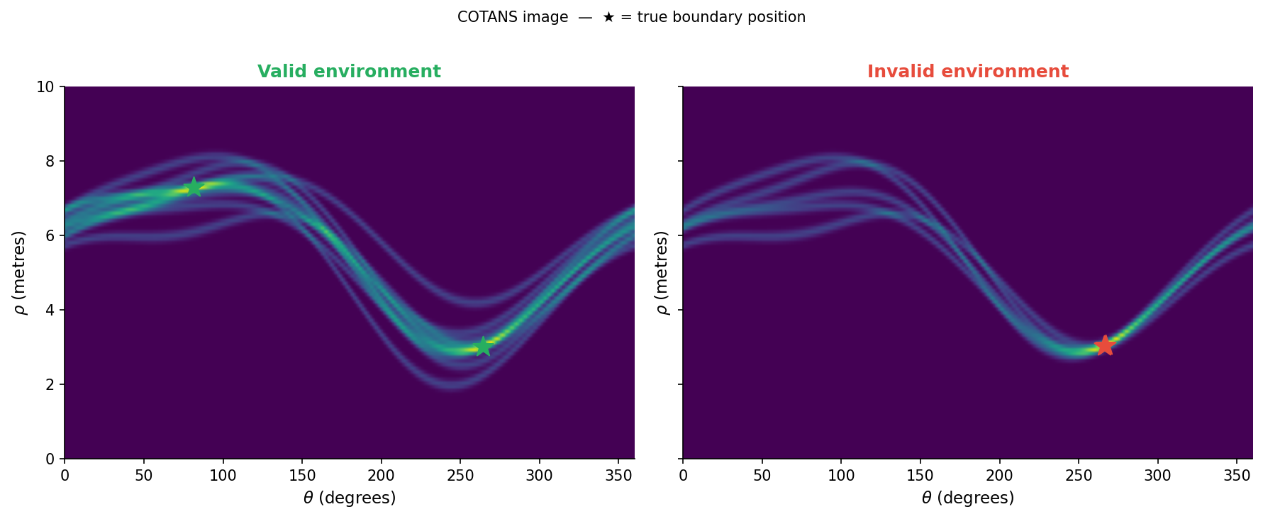
FOUNDATION · FEB – MAR
What makes an environment valid?
The first task wasn't ML at all.
KEY FAILURE MODE
Vary boundary distance, angle, count, and separation. Generate hundreds of COTANS images. Report which configurations the network can actually read.
The criteria I extracted became the validity ruleset I later fed to the LLM.
Left: two distinct bright peaks the network can read.
Right: boundaries placed too close — peaks merge into one blurry region.
Output: a concrete validity ruleset.
NeuroCotans · Amir Tomashpayev · Spring 2026
4 / 9

Slide 5

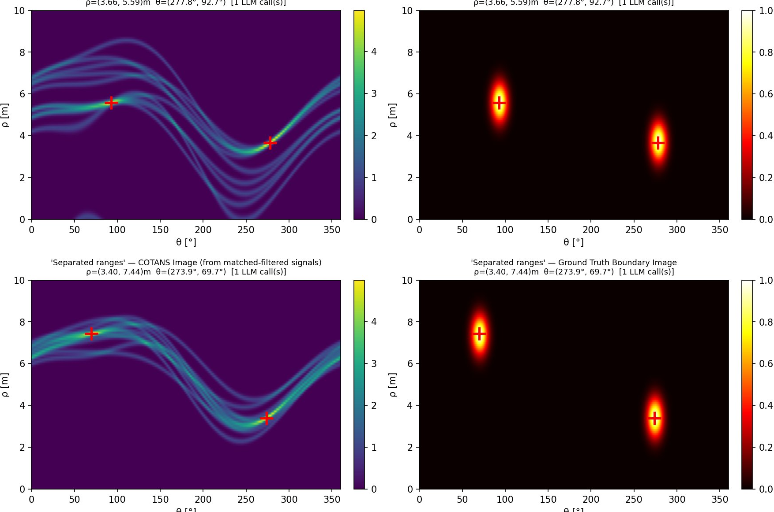
CONTRIBUTION 1 · APRIL
An LLM that generates valid environments
THE SETUP
Local Llama via Ollama — runs on the lab machine, no API.
Validity ruleset as the system prompt.
Structured JSON output → straight into the simulator.
FOUR SPATIAL TESTS
01
One per region
02
Range split 3–4 vs 7–9 m
03
Opposite sides
2 of 4 LLM-generated scenarios · COTANS image (left) → ground truth (right)
04
Close pair, > 80° apart
4 / 4 scenarios on first call · but ~700× slower than random
NeuroCotans · Amir Tomashpayev · Spring 2026
5 / 9

Slide 6


CONTRIBUTION 2 · APRIL
MC Dropout — uncertainty for free
THE GAP
30 PASSES, SAME INPUT
NeuroCotans always outputs a prediction —
CONFIDENT
UNCERTAIN
but never says how much to trust it.
ρ = 4.2 m, θ = 127° looks identical whether the network is certain or completely guessing.
THE TRICK
ZERO RETRAINING
1. Keep dropout ON at inference.
2. Run the same image 30 times.
3. Spread of predictions = uncertainty.
The trained UNet already has 18 Dropout2d layers. Three lines flip them on at inference.
NeuroCotans · Amir Tomashpayev · Spring 2026
6 / 9

Slide 7
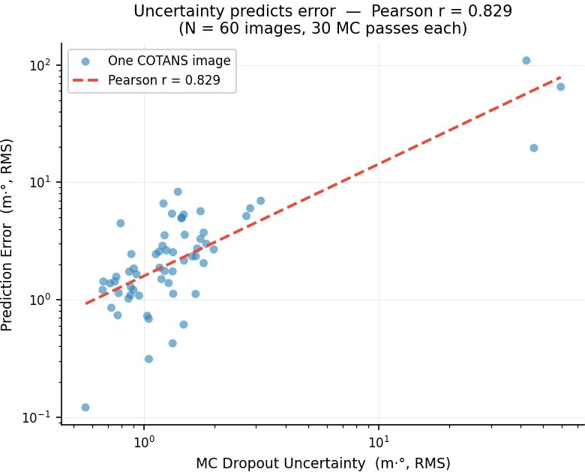
CONTRIBUTION 2 · EXPERIMENT 1
Uncertainty predicts error
THE EXPERIMENT
60 environments · 30 MC passes each
For every image, plot the spread of the 30 predictions against the actual error vs ground truth.
PEARSON CORRELATION
r = 0.83
The network reliably signals when it will be wrong.
NeuroCotans · Amir Tomashpayev · Spring 2026
7 / 9

Slide 8
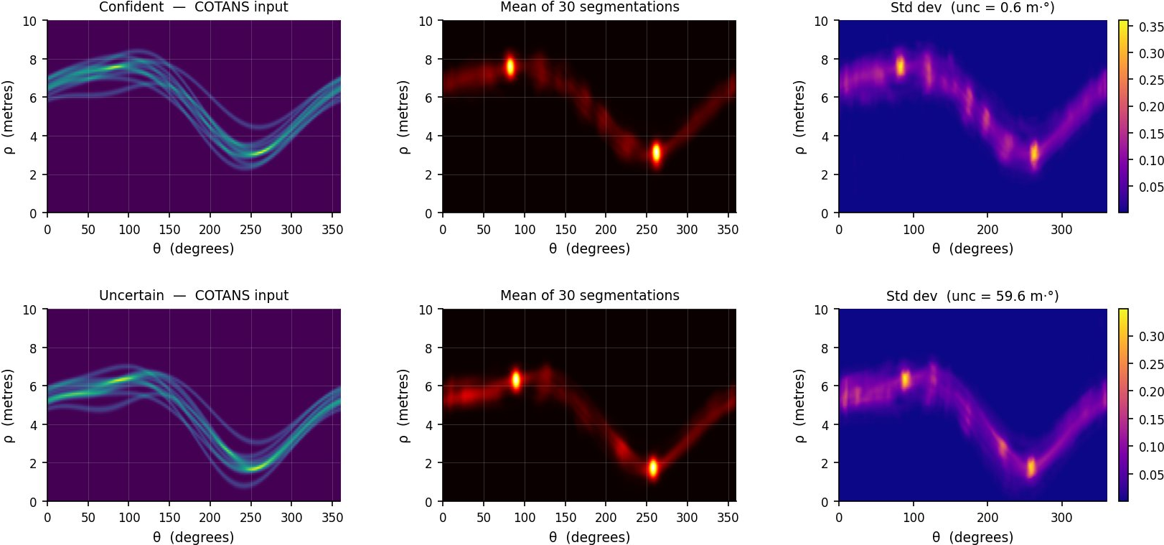
CONTRIBUTION 2 · EXPERIMENT 2
Where in the image is the network unsure?
THREE COLUMNS
1. COTANS input
the heatmap fed to the network.
2. Mean prediction
average of 30 segmentations.
3. Pixel-wise std dev
exactly where the network is unsure.
Top row uncertainty = 0.6 m·° · Bottom row uncertainty = 59.6 m·° · same architecture, same weights, no retraining.
NeuroCotans · Amir Tomashpayev · Spring 2026
8 / 9

Slide 9

CLOSING
Two takeaways · Live demo
TAKEAWAY 1
LIVE DEMO
LLMs understand domain rules
Streamlit app
…but won't outpace simple random sampling in a well-constrained parameter space. Useful as a steerable interface, not a speed-up.
Drag the SNR slider
Generate a new environment
TAKEAWAY 2
Watch the uncertainty react
The trained model already knew
Useful uncertainty information was sitting inside the existing UNet — extractable at zero retraining cost, including OOD detection.
▶
streamlit run amir/streamlit_demo.py
Thank you · Questions?

